Slide 1
Linked List ADT
Pranay Netha Guda

Slide 2
Problems With Array
Size is Fixed ---We need to Resize the array every time Capacity is Full.

Slide 3
Inserting an Element in an Array
1. Get the element value which needs to be inserted.
2. Get the position value.
3. Check whether the position value is valid or not.
4. If it is valid,
Shift all the elements from the last index to position index by 1 position to the right.
insert the new element in arr[position]
5. Otherwise,
Invalid Position

Slide 4
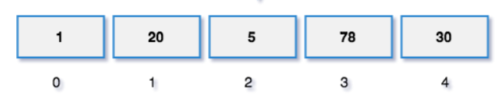
Example
Assume there is an Array:
If we need to insert an element 100 at position 2

Slide 5
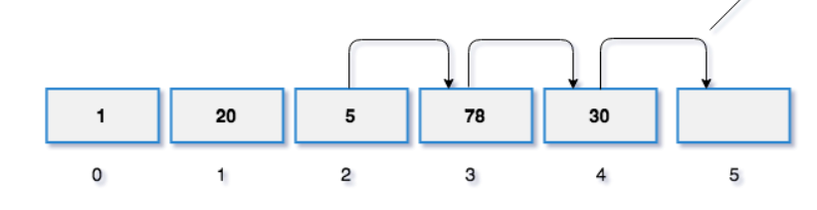
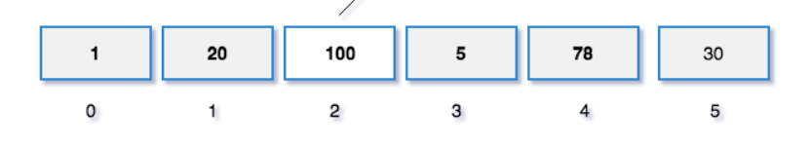




Slide 6
Conclusion
To insert an element in Array to the extreme right takes a time complexity of O(1)
When an Element is to be Inserted anywhere in the middle or start of the Array Takes you O(n)

Slide 7
Why ???
What is the need for Creating a new Array during Resizing Operation?
Why array's Elements are stored in Contiguous Memory?

Slide 8
Need Of A Data Structure
Which can store Elements in Non Contiguous Memory Locations
So Elements Can be Added Anywhere in The Memory Heap
No Need of Allocating a Dedicated Place in the Memory Space
No Need of Resizing
Find a Way to Link This Memory Blocks to Maintain The Integrity of the Data and Order

Slide 9
Linked List
A linked list is a linear data structure that stores a collection of nodes connected together via links.
What's A Node:
A Element Where Data Is Stored--
It Can Be stored Anywhere in The Memory
What's A Link:
A Way to Connect All these Nodes from Different Memory Locations to maintain the order and Integrity of Data Structure

Slide 10
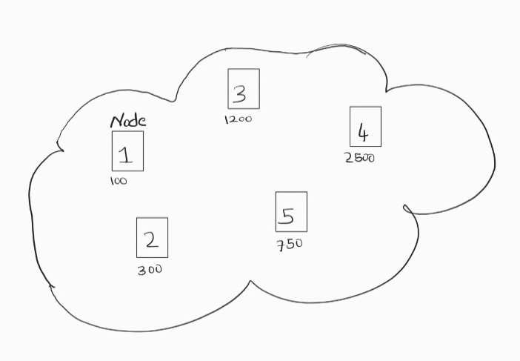
How the Nodes are Stored in Memory

Slide 11
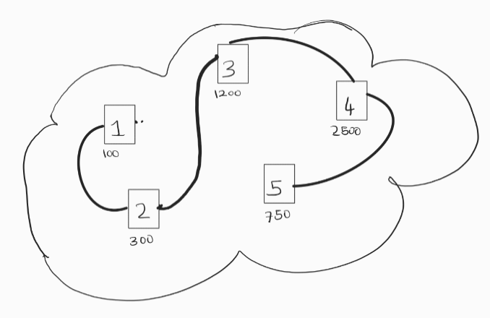
We Need To Find A way To Connect Them

Slide 12
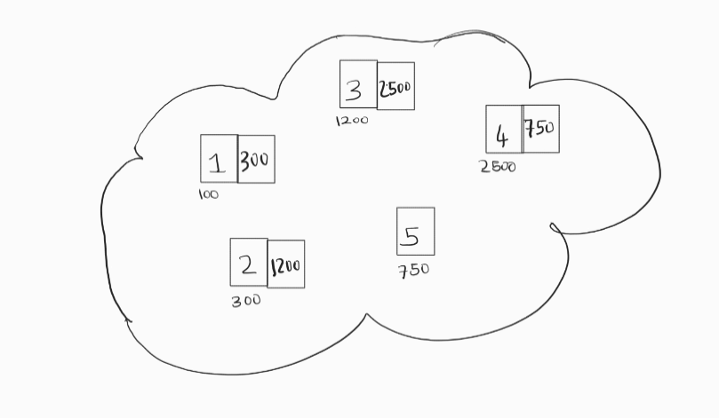
Can Be Interlinked Via Addresses OF Nodes

Slide 13
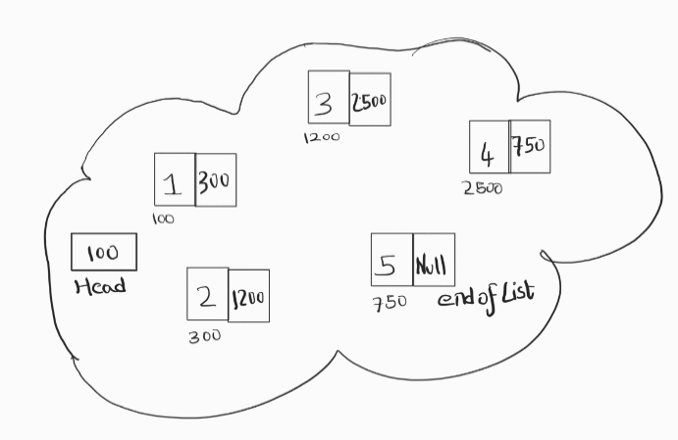
Where Does a Linked List Start And End???

Slide 14
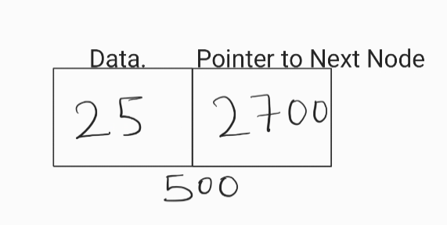
Node
Node object has
One data element, type T
Pointer to next node

Slide 15
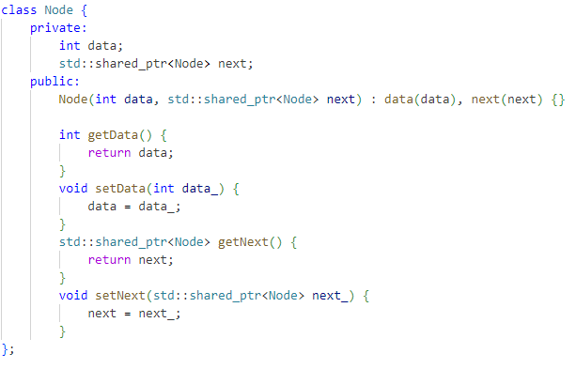
Creating A Node in C++

Slide 16
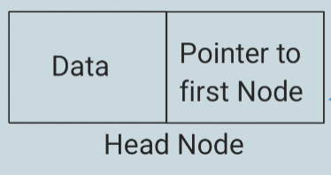
Singly Linked List Elements
List Object Has Pointer To The Head Node
Size:Keeps Track Of Number Of Elements in Linked List

Slide 17
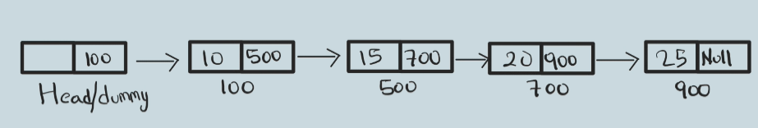
Singly Linked List

Slide 18
Terminology
Head Node- A Node Which Points To the First Element Of List
Node.Next()-Return a A Pointer Which Points to the Next Node.
Data-A Data Element to The Node

Slide 19
Singly Linked List DrawBacks
Points Only to the Head Element
To Reach the End of Linked List Need to Traverse The Entire Linked List

Slide 20
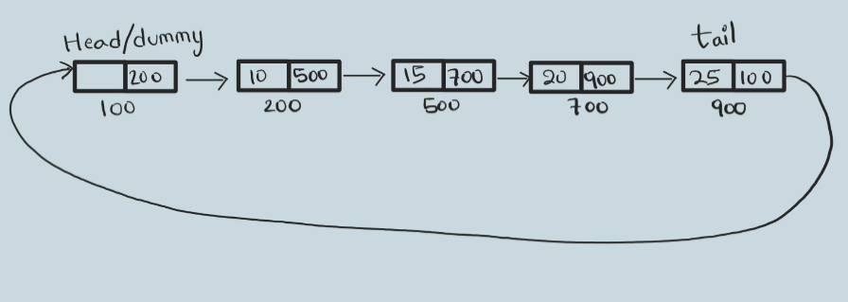
Circular Variant of Single Linked List

Slide 21
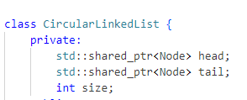
Elements Of Circular Linked List
Head->A node Which Points to the First Element Of Linked List
Tail->A Node which is to End Of Linked List and Points To Head Node
Size->Keeps Tracks Of Number Of Elements On Linked List

Slide 22
Terminology Of Circular Linked List
TailNode->Is The Last Element and Keeps A Pointer To Head Node
TailNode.Next()->HeadNode
HeadNode.Next()->First Node
Node1.Next()=Node2
Means That Node 1 is Pointing to The Node2
createNode(Data, next): Represents a function to create a new node with the given data and the next pointer.
setNext(node, next): Represents a function to set the next pointer of the given node to the specified next node.
getNext(node): Represents a function to get the next node of the given node.

Slide 23
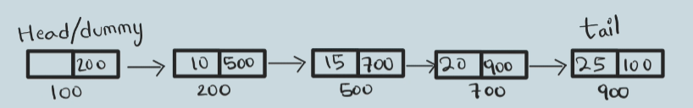
Operations On Circular Linked List

Slide 24
MakeNode()
NewNode=MakeNode(Value, Ptr To Next Node )
Time Complexity –O(1)
std::shared_ptr<Node> newNode = std::make_shared<Node>(Data,head);

Slide 25
GetNode OperationLinked List
Return The Node at Index I
Function GetNode(index):
if index < 0 OR index >= size:
print "Index out of range"
else:
current = head.getNext()
for i from 0 to index - 1:
current = current.getNext()
return current

Slide 26
Time Complexity of GetNode(i)--O(n)
Worst Case Has to Traverse The Entire Linked List get the Node
std::shared_ptr<Node> GetNode(int index){
if(index < 0 || index >= size){
std::cout << "Index out of range" << std::endl;
}
else{}
std::shared_ptr<Node> current = head->getNext();
for(int i = 0; i < index; i++){
current = current->getNext();
}
return current;
}

Slide 27
Traverse Linked List
PROCEDURE Traverse
SET current = head->next
i=0
WHILE i<size DO
PRINT current.data
SET current = current.next
increment i
END WHILE
END PROCEDURE
Time Complexity of Traverse()--O(n)
Need to Traverse The Entire Linked List

Slide 28
Traverse Linked List-Code
void Traverse(){
std::shared_ptr<Node> current = head->getNext();
for(int i = 0; i < size; i++){
std::cout << current->getData() << " ";
current = current->getNext();
}
std::cout << std::endl;
}

Slide 29
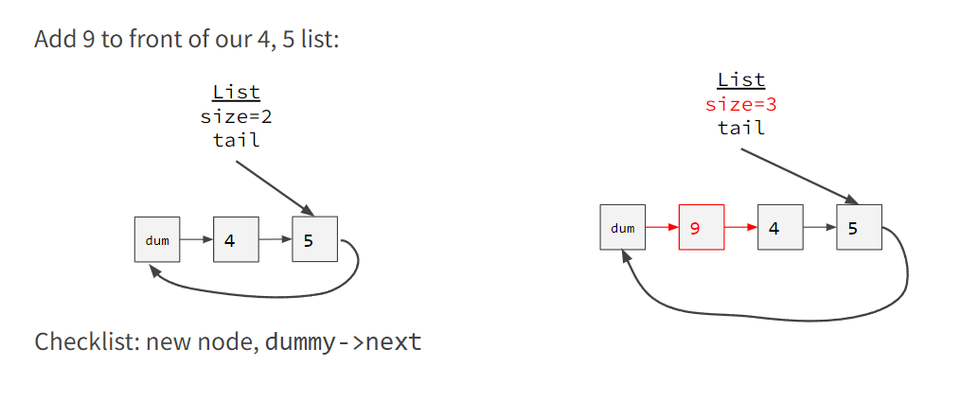
PushFront

Slide 30
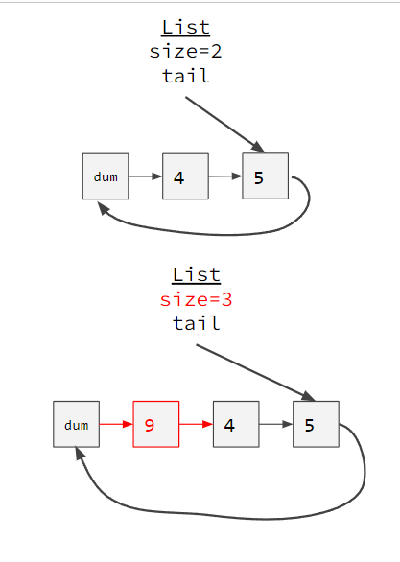
Function pushFront(Data):
newNode = createNode(Data, null)
if size equals 0:
setNext(head, newNode)
tail = newNode
setNext(newNode, head)
else:
setNext(newNode, getNext(head))
setNext(head, newNode)
increment size
Time Complexity O(1)

Slide 31
Push Front Code
void pushFront(int Data){
std::shared_ptr<Node> newNode = std::make_shared<Node>(Data,nullptr);
if(size == 0){
head->setNext(newNode);
tail = newNode;
newNode->setNext(head);
}
else{
newNode->setNext(head->getNext());
head->setNext(newNode);
}
size++;
}

Slide 32
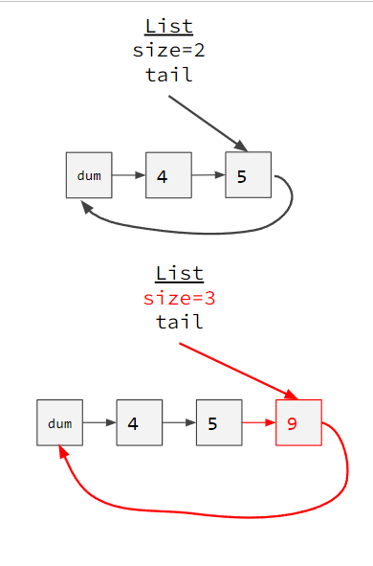
PushBack
function pushBack(Data):
newNode = createNode(Data, head)
if size equals 0:
tail = newNode
setNext(head, newNode)
else:
setNext(tail, newNode)
tail = newNode
increment size

Slide 33
void pushBack(int Data){
std::shared_ptr<Node> newNode = std::make_shared<Node>(Data,head);
if(size == 0){
tail = newNode;
head->setNext(newNode);
}
else{
tail->setNext(newNode);
tail = newNode;
}
size++;
}

Slide 34
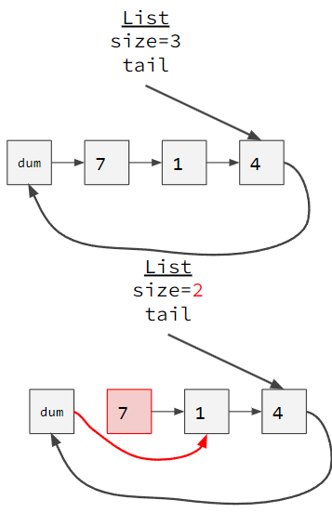
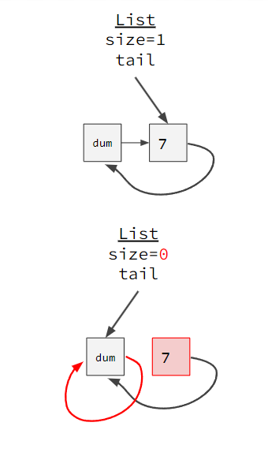
PopFront
function popFront():
if size equals 0:
output "List is empty"
return
current = getNext(head)
setNext(head, getNext(current))
decrement size

Slide 35
Code-Pop Front
void popFront(){
if(size == 0){
std::cout << "List is empty" << std::endl;
return;
}
std::shared_ptr<Node> current = head->getNext();
head->setNext(current->getNext());
size--;
}

Slide 36
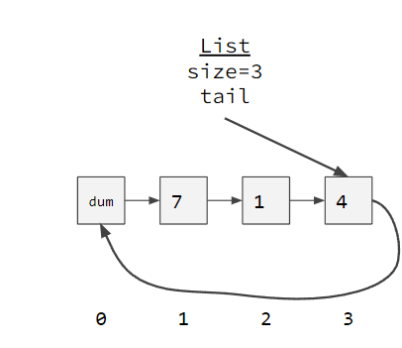
Get(I)
function getVal(index):
if index less than 0 or index greater than or equal to size:
output "Index out of range"
return -1
current = GetNode(index)
return getData(current)
Time Complexity---O(n)
int getVal(int index){
if(index < 0 || index >= size){
std::cout << "Index out of range" << std::endl;
return -1;
}
std::shared_ptr<Node> current = GetNode(index);
return current->getData();
}

Slide 37
Set(Value,I)
function setVal(index, Data):
if index less than 0 or index greater than or equal to size:
output "Index out of range"
return
current = GetNode(index)
setData(current, Data)
Time Complexity---O(n)
void setVal(int index, int Data){
if(index < 0 || index >= size){
std::cout << "Index out of range" << std::endl;
return;
}
std::shared_ptr<Node> current = GetNode(index);
current->setData(Data);
}

Slide 38
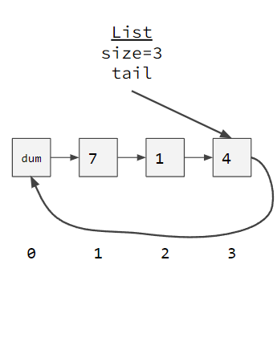
PopBack()
function popBack():
if size equals 0:
output "List is empty"
return
current = GetNode(size - 1)
setNext(current, head)
tail = current
decrement size
TimeComplexity-O(n)

Slide 39
Code-PopBack()
void popBack(){
if(size == 0){
std::cout << "List is empty" << std::endl;
return;
}
std::shared_ptr<Node> current = GetNode(size-1);
current->setNext(head);
tail = current;
size--;
}

Slide 40
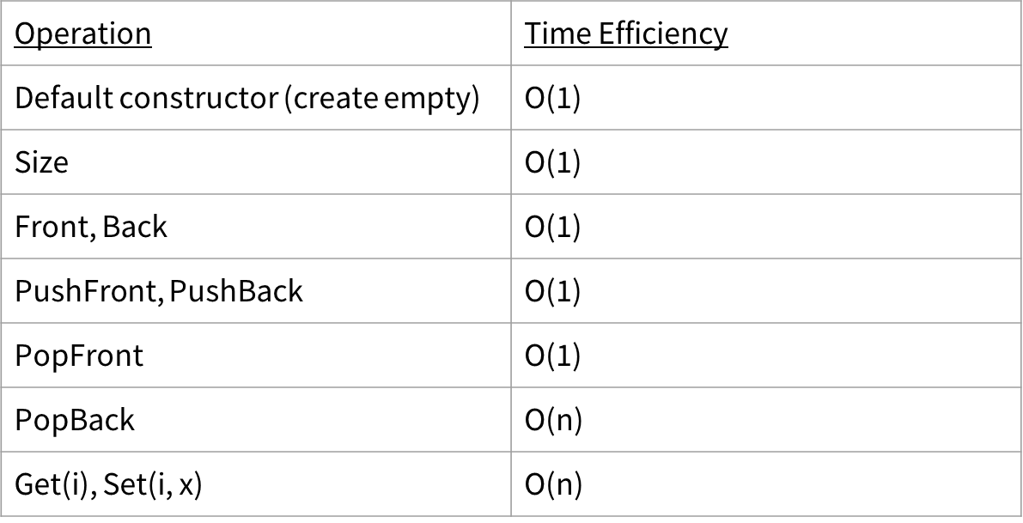
Linked List Operations

Slide 41
Need Of Using a Destructor

Slide 42
Understand the Problem
Using std::shared_ptr
Reference counting (refcount)
Default constructor leaves all nodes with refcount=1
Memory leak
Need non-default constructor that makes refcount=0

Slide 43
Reference Counts
reference count (refcount) = #incoming shared pointers
List
size=3 tail
1
1
1
2
dum
7
1
4

Slide 44
Reference Counts After Destructor
reference count (refcount) = #incoming shared pointers
List
size=3 tail
1
1
1
2
1
dum
7
1
4

Slide 45
Solution
Explicit destructor
Removes all nodes
Only dummy node remains
Break dummy node’s circular link

Slide 46
Destructor
List
size=3 tail
~SLList() { while (size_ > 0) { PopFront(); } tail_->SetNext(nullptr); }
dum
7
1
4
O(n) time

Slide 47
Destructor Sketch
reference count (refcount) = #incoming shared pointers
~SLList() { while (size_ > 0) { PopFront(); } tail_->SetNext(nullptr); }
List
size=3 tail
1
1
1
2
dum
7
1
4

Slide 48
Destructor Sketch
reference count (refcount) = #incoming shared pointers
~SLList() { while (size_ > 0) { PopFront(); } tail_->SetNext(nullptr); }
List
size=2 tail
1
1
2
dum
1
4

Slide 49
Destructor Sketch
reference count (refcount) = #incoming shared pointers
~SLList() { while (size_ > 0) { PopFront(); } tail_->SetNext(nullptr); }
List
size=1 tail
1
2
dum
4

Slide 50
Destructor Sketch
reference count (refcount) = #incoming shared pointers
~SLList() { while (size_ > 0) { PopFront(); } tail_->SetNext(nullptr); }
List
size=0 tail
2
dum

Slide 51
Destructor Sketch
reference count (refcount) = #incoming shared pointers
~SLList() { while (size_ > 0) { PopFront(); } tail_->SetNext(nullptr); }
List
size=0 tail
2
1
dum
nullptr

Slide 52
Destructor Sketch
reference count (refcount) = #incoming shared pointers
~SLList() { while (size_ > 0) { PopFront(); } tail_->SetNext(nullptr); }
List
size=0 tail
1
0
dum
nullptr

